Slide 1

AX Sucks.
Let’s talk Upgrades.

Slide 2
Synopsis
Discuss reasons to upgrade; areas of improvement, discuss other products that integrate well like CE, Project Ops, field Service, Power Platform plus dual write. Also discuss what you need to do to be ready for an upgrade. What pre-work or homework is there before you make the decision. We’ll look at all the available products in the Dynamics and Power Platform space available for your business, not just Finance and Operations.
PowerPoint available for download at https://github.com/NathanClouseAX/CommunityPresentations/tree/master/2021

Slide 3
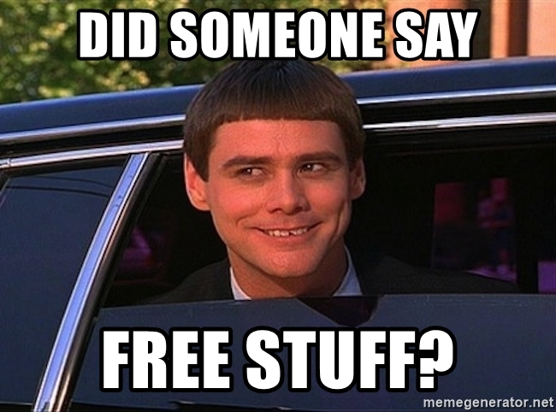
Free Stuff
Gift Card Give Away!

Slide 4

Kelly Gustafson
Sr. Functional Consultant/Engagement Manager at Alpha Variance Solutions
Microsoft MVP/MCT
Kgustafson@alphavsolutions.com
www.d365fandom.com
@KellyLappG

Slide 5

Nathan Clouse
Technical Architect enVista Corp.
Microsoft Business Applications MVP
nclouse@envistacorp.com
www.atomicax.com
@NathanClouseAX

Slide 6
What we’ll cover today
Upgrade Paths
What’s different in Finance and Operations?
Client
Integration
Excel
Data Management
Functional Features
Technical Features
Everything outside of F&O
Customer Engagement (CE)
Field Service (FS)
Project Operations (ProjOps)
Power Platform

Slide 7

Upgrades – Why do I need this?
Your system is nearing the end of Microsoft support!
AX 2009
AX 2012
Mainstream support ended October 9, 2018
Extended support ends – April 12, 2022
AX 2012 RTM & R2 – Mainstream support ended Oct 9, 2018
AX 2012 RTM & R2 – Extended support ends April 12, 2022
AX 2012 R3 – Mainstream support ends October 12, 2021 (YESTERDAY)
AX 2012 R3 – Extended support ends January 10, 2023
End of mainstream support for Microsoft Dynamics AX 2009, Dynamics AX 2012, and Dynamics AX 2012 R2 - Finance & Operations | Dynamics 365 | Microsoft Docs

Slide 8
Upgrades – Where to Start?
What do I want to get?
Technical Upgrade?
Redesign processes?
Less Infrastructure?
Get onto something that is support?
Power Platform? Customer Engagement? Project Operations? Field Service?
Apps and integrations?
Am I on a supported version?
AX 2012 RTM?
AX 2012 R2?
AX 2012 R3?
AX 2009?
Prework / Homework?

Slide 9
Upgrade Paths
AX 2009
Migrate Master Data
Transactions not included
Must Install Data Migration Tool from MSFT (DMT)
AX 2012 R2 / R3
Install KB for update
Run Checklist
Copy database to F&O Environment
Execute data upgrade
Use LCS to upgrade modelstore
Manually upgrade code it can’t handle
Notes:
Links
https://dynamics.microsoft.com/en-us/migration-program/
https://microsoft.qualtrics.com/jfe/form/SV_brOLCioQ7mmeykB

Slide 10

ERP is cheap now, everything around it is expensive

Slide 11

What’s new in Finance and Operations?
New modules!!
Asset Management
Asset Leasing
Cost Accounting
Cost Management
Credit Management
Engineering Change Management
Retail
Tax
Warehouse management (new-ish)

Slide 12

What else?
Human Resources is moving BACK into F&O
Planning optimization
Payment Predictions
Workspaces
Task recorder is AWESOME
User options provide greater accessibility for users to modify their own instance

Slide 13


Upcoming
New features are always coming and can be found within the Dynamics 365 Release Plan in Microsoft Docs
Microsoft Dynamics 365 2021 release wave 2 plan overview | Microsoft Docs

Slide 14

FIELD SERVICE
Asset integrations with Asset management through Dual-Write in F&O
Data integrator for Work orders into Sales orders that can be invoiced in F&O

Slide 15
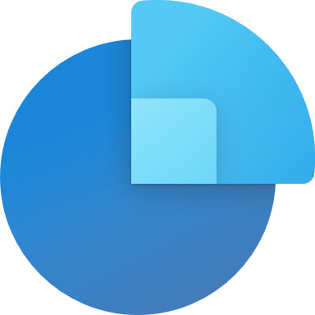
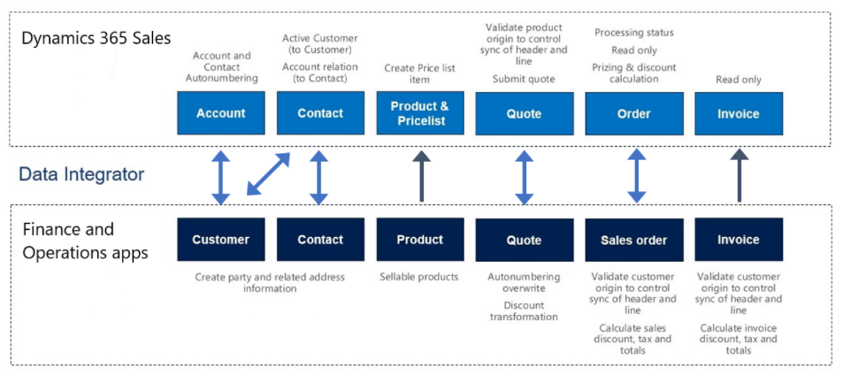
SALES (CRM)
Integration with Dual-Write for
Customers
Contacts
Quotes
Sales orders
Products

Slide 16

PROJECT OPERATIONS
Integration between CE and F&O expands power and capabilities for people who need integration for projects within Sales, Marketing, and Service.​
Projects scheduling using resource scheduling

Slide 17

POWER APPS
Integrated into D365FO
Mobile workspaces are going to become Power Apps SOON
Power Automate (Flow)

Slide 18
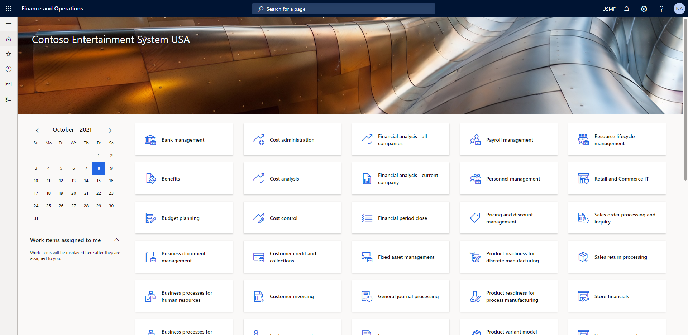
Client
Web Based
Microsoft Edge (recommended: Chromium-based Edge)
Google Chrome
Apple Safari
Internet Explorer 11 (deprecated, not recommended)
Now entirely a web app

Slide 19

Integrations
Lots of new options
Power Platform
OData
Batch Data API
Custom Services
Consume External APIs
Excel Integration
Dual Write
Business Events
LCS Microservices
Plus
Every single Azure Tool available
Recurring Integration Scheduler

Slide 20

Shameless Plug
Want to know more about integrations? Attend…
Automatically Import Sales Orders in Dynamics Finance & Operations Using AI Builder
Dynamics 365 Finance & Operations and Customer Engagement: Interface Strategies Using Azure Integration Tools
Dynamics 365 F&O Business Events From End to Start to End
F&O Integration Roundup
Dynamics 365 F&O OData From Zero To Hero

Slide 21
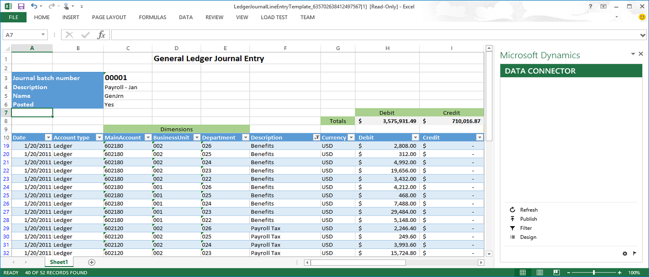
Excel
Excel Add-in for F&O
Do you have Atlas? It’s like that
Export data out into Excel
Modify data and upload it back into F&O

Slide 23
Excel
Excel Add-in for F&O
Do you have Atlas? It’s like that
Export data out into Excel
Modify data and upload it back into F&O

Slide 24
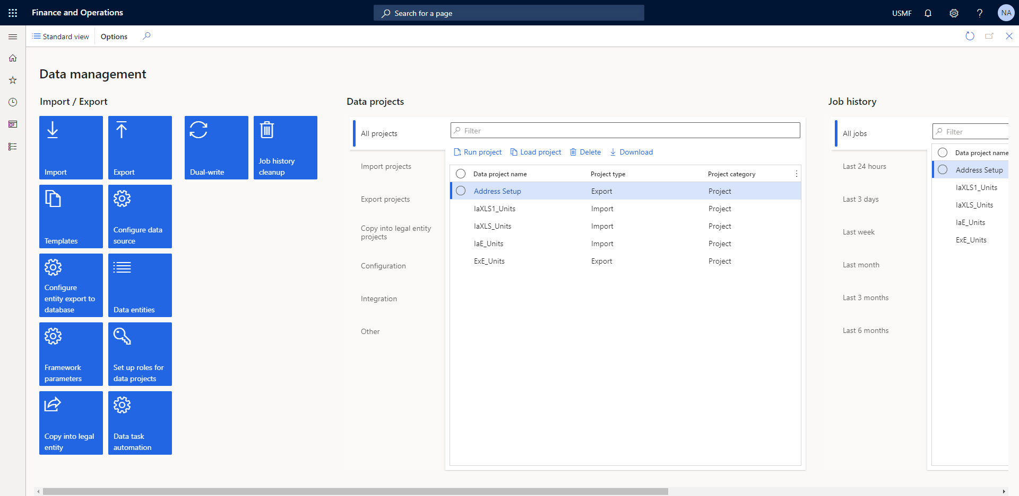
Data Management
Replacement for DIXF from AX 2012
Full-featured data management
Import and Export
UI
API
Data Entities wrapped around core concepts
Projects collect your entities for your use case
Jobs do the work
Data Packages let you rapidly import and export large, complex data projects

Slide 26
Data Management
Replacement for DIXF from AX 2012
Full-featured data management
Import and Export
UI
API
Data Entities wrapped around core concepts
Projects collect your entities for your use case
Jobs do the work
Data Packages let you rapidly import and export large, complex data projects

Slide 27


Technical Features
MorphX reports are officially dead
Visual Studio
Packages and Models
Integration with source control
Automated Builds and Deployments
2 basic types of environment
T1 – prebuilt image that you makes copies of on prem or in the cloud
T2 – Managed and built by MSFT

Slide 28
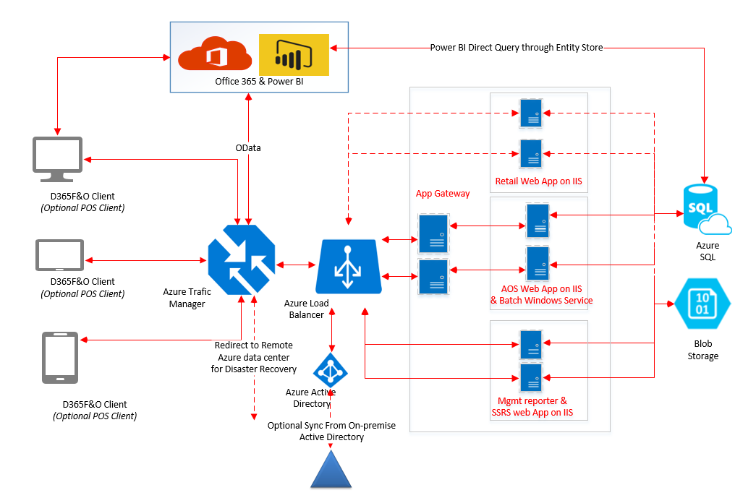
Technical Features
No Installer
Hosted in IIS
Batch Server is stand-alone
Deploy Binaries only
All deployments are through LCS
Life Cycle Services
Cloud and on prem versions

Slide 30
Technical Features
No Installer
Hosted in IIS
Batch Server is stand-alone
Deploy Binaries only
All deployments are through LCS
Life Cycle Services
Cloud and on prem versions

Slide 31

Pre-work/Homework
Clean up your data!
Look at mapping
Is your data transferrable?
If there is a process you hate, NOW is the time to consider changing it.
Review your customizations
Are they needed?
Is there something that is now available OOTB to meet this need?

Slide 32
Questions?

Slide 33
Dynamics 365: Let’s talk Upgrade Rollout Approach (AX 2012 Upgrade Series: Part 6) – Tuesday @ 2:00
Dynamics 365 F&O Licensing, Upgrades, Costs and More (Part 2) – Tuesday @ 3:00
Retail and Warehousing: The Biggest Areas for Change in Dynamics 365 F&O (AX 2012 Upgrade Series: Part 3) – Wednesday @ 9:30
AX Sucks. Let’s talk Upgrades (AX 2012 Upgrade Series: Part 1)– Wednesday @ 10:30
An AX2012 Upgrade Journey - Wednesday @ 11:30
Dynamics 365 F&O Business Events From End to Start to End – Wednesday @ 1:40
Dynamics 365 F&O Upgrade Tech Talk: Code, Customizations, Extension and Power Platform (AX 2012 Upgrade Series: Part 5) – Thursday @ 10:00
How To Get The Most Out of Your Upgrade (AX 2012 Upgrade Series: Part 2) – Thursday @ 1:10

Slide 34
Kelly’s Other Presentations
Commerce 101 – Tuesday @ 1:00 pm
AR Tips and Tricks – Tuesday @ 2:00 pm
How to get the Most Out of Your Upgrade (AX 2012 Upgrade Series: Part 2) – Thursday @ 1:10 pm
Asset Management vs Field Service – Thursday @ 2:10 pm

Slide 35
Nathan’s Other Presentations
Dynamics 365 F&O Business Events From End to Start to End – Wednesday @ 1:40
Dynamics 365 F&O OData From Zero To Hero – Thursday @ 9:00
F&O Integration Roundup - Thursday @ 11:00
X++ Development Tips and Tricks plus D365FO.Tools! – Thursday @ 2:10

Slide 36
Give Away!

Slide 37




About AVS
Founded 2015 | New York
Woman-Owned Business
Microsoft Gold Partner |
Direct CSP
New York |Düsseldorf |Bangalore
Booth #756

Slide 38

Please visit our booth
enVista booth #700
Meet with our experts
Learn about industry-leading practices
Get the most from your Microsoft investments
Register to win a YETI™ cooler
enVista
Booth
Hall C Entry

Slide 39

Survey Code

